Slide 1
Power Integrity Optimization using eCADSTAR

Slide 2
Base design
Impedance spectrum for No decap on the board.

Slide 3
Objective
Design Chatbot for SI/PI/EMC support in PCB design.
Goals: Improve interaction, accessibility, response quality and Tools access.
Added Functionalities:
  Handling Images,PDF,Word
  Access To Web search
  Access To eCADSTAR Simulations

Slide 4
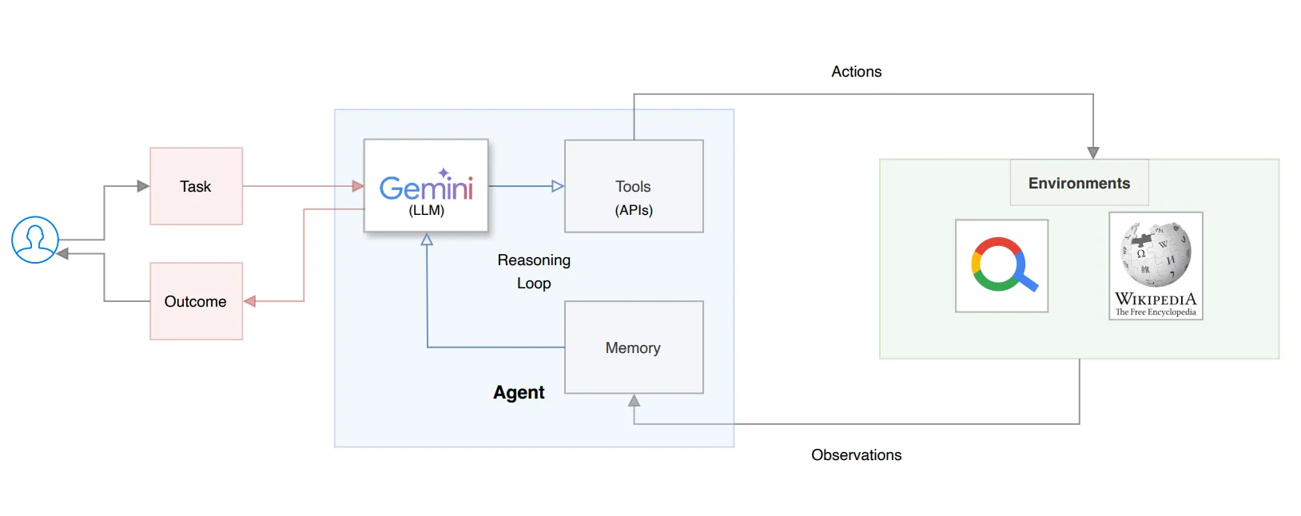
ReAct Framework
Reasoning + Action

Slide 5
Handling Images
Images to text(descriptions) - Multimodel
Descriptions + User Question
Feed to the LLM(orchestrator)
Why ? :
Simple to implement with smaller models and during fine-tuning.

Slide 6
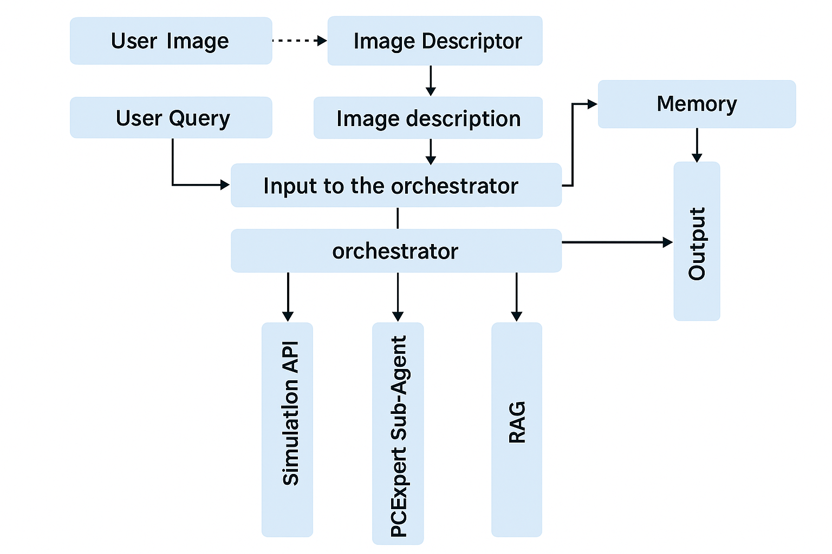
Agent Architecture

Slide 7
Orchestrator
Orchestrator breaks down User Question.
Gives responses for next step (thoughts)
  Action
  Final Answer
Multi-hop queries require multiple reasoning steps to arrive at the final answer in ReAct Agent.
Deepseek 70b distilled , gpt-4o,gemini 1.5 pro

Slide 8
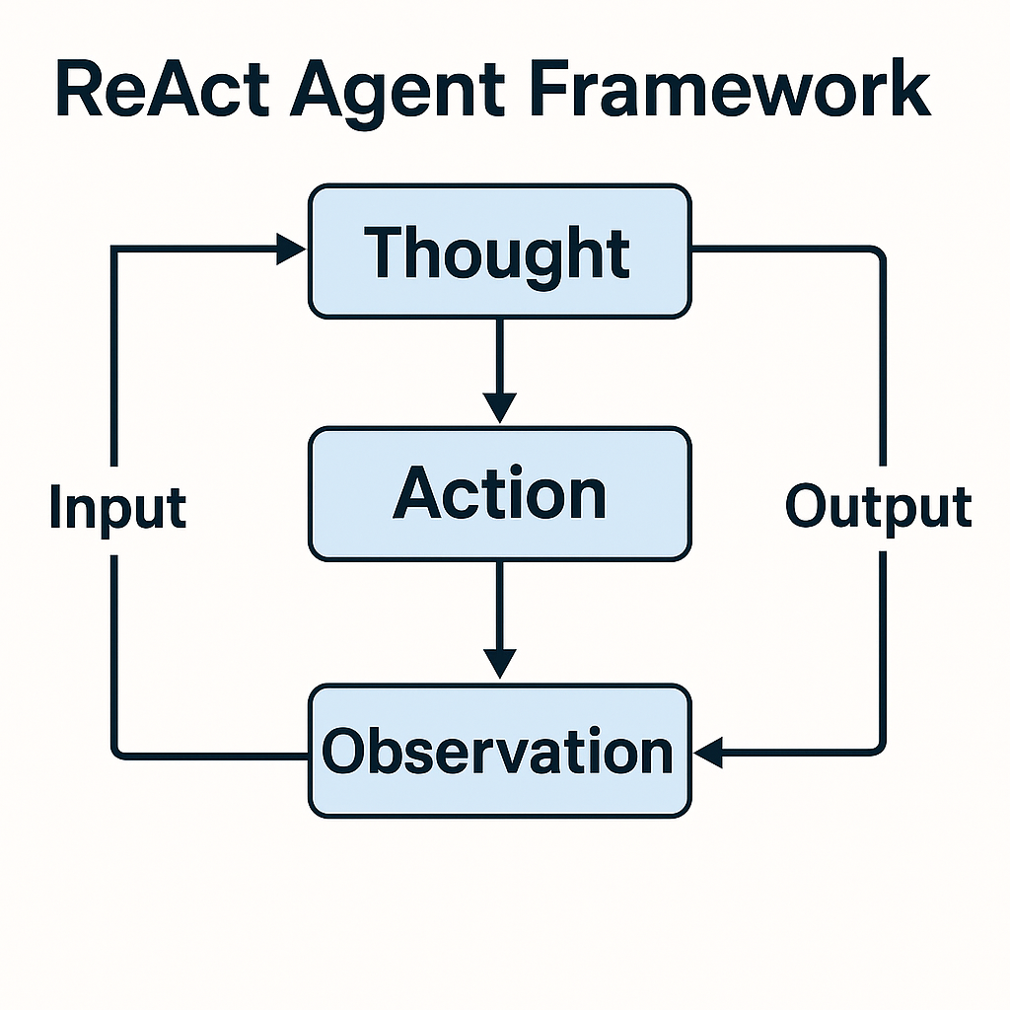
Tools
Make the agent more powerful by connecting it to outside systems, APIs, or information sources.
The orchestrator chooses when and how to use these tools.
Our agent has the following tools:
  Simulation
  PCB Expert
  RAG

Slide 9
Simulation
eCADstar Electrical editor simulations.
  Supports FD,SI,TDR
  Dynamically modify resistor value & Transmission length.
No CLI instead Pyautogui hotkeys
Orchestrator
Semantic search
eCADstar
Image descriptor

Slide 10
PCB Expert
Usual LLM fine tuned with domain dataset. (sub-agent)
Why ? - Easy to implement with minimal datasets.
Difficult to generate ReAct datasets.
We can include domain knowledge for the Agent.
Deepseek 8b , lama 8b - fine tuned

Slide 11
VLM Models Overview
Model | Size | Key Features
LLaVA-1.6-Mistral (LLaVA-NeXT) | 7.57B | Supports different resolutions and aspect ratios of images 672x672, 336x1344, 1344x336 pixels, by incorporating an “AnyRes” technique, that leveraging flexible grid configurations. This ensures that the visual details are preserved and reduce hallucinations for low-res images. Performs better than it’s previous version LLaVA-1.5 in OCR, visual reasoning and conversation scenarios.
SmolVLM-Instruct | 2.25B and 507M | Based on the Idefics3 model architecture. The images are compressed by around 9 times using pixel shuffle strategy. It also has exceptional memory usage, for eg. it encodes 384x384 image to 81 tokens which results so that the test prompt with one image only results in 1.2k tokens compared to 16k in models like Qwen2-VL. Different variations of the model are present, where the difference is in the image compression strategy and optimizing visual token encoding.
Qwen2.5-VL | 8.29B | Has enhanced OCR and text recognition optimized for multi-scenario and multi-language tasks, making it good for extracting data from documents and diagrams. The model handles spatial data more efficiently like converting various sizes of images to tokens of different lengths using actual scale of image, eliminating the need for normalization. The other main improvement was using a custom Vision Transformer for encoding the images.
Granite-Vision-3.2 | 2.98B | This model is tailored for visual document understanding. This model was pretrained on data such as charts, graphs, infographics, plots, etc. This makes the model perform better on extracting data from these type of images and documents.

Slide 12
VLM Models Training Parameters
Models are quantized to 4-bit quantization
Models are fine-tuned on LoRA adapters (Low-Rank Adaptation)
Models are trained for one epoch and the training loss and mean-token accuracy are logged using Tensorboard for every 10 steps during the training.
A system message is set for all the models in the dataset for further aligning the model for the task.
After fine-tuning, the fine-tuned models are uploaded to HuggingFace for easier access and use.
System Message:
"You are a Vision-Language Model specialized in interpreting PCB circuit designs and waveform simulation graphs. Your task is to analyze the provided image, determine whether it is a circuit schematic, PCB layout, or waveform simulation graph, and generate a structured, technically detailed description. For circuit schematics and PCB layouts, identify the circuit topology, functional blocks, component details, signal flow, electrical parameters, and PCB layout considerations. For waveform simulation graphs, extract key waveform characteristics, analyze signal integrity, and assess circuit performance. Focus on delivering precise, structured, and insightful technical descriptions based on visual information. Avoid unnecessary elaboration beyond what is essential for accuracy."

Slide 13
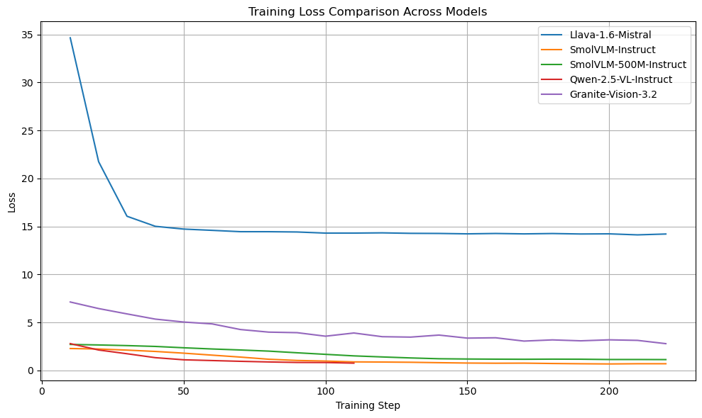
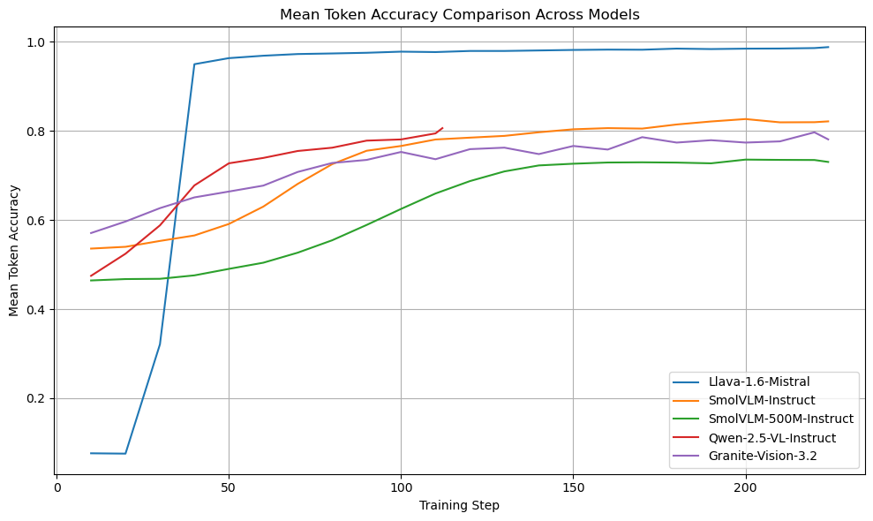
VLM Models Training Loss and Accuracy

Slide 14
Model Performance
FinalScore = 100 * (0.6 * AccNorm + 02 * TimeNorm + 0.2 * SizeNorm)
Circuit Images
SI Analysis Images
FD Analysis Images
TDR Analysis Images

Slide 15
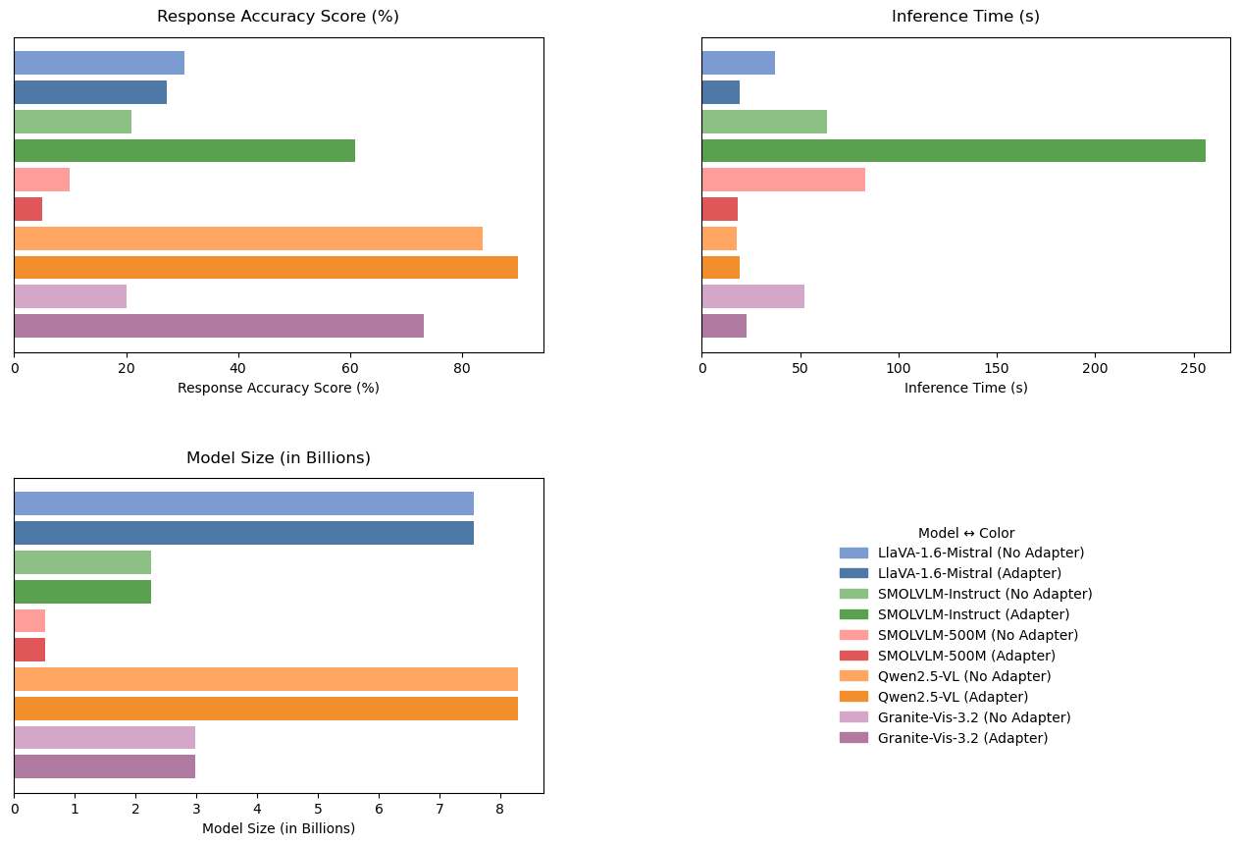
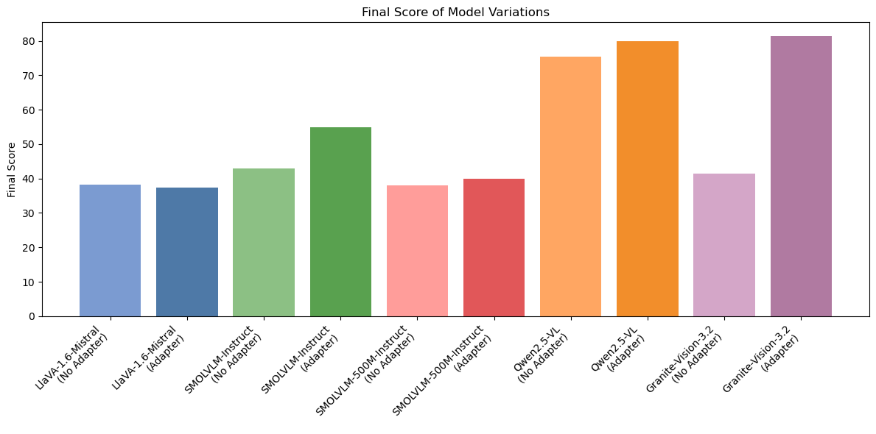
Circuit Image Performance Evaluation

Slide 16
Circuit Image Performance Evaluation
Model Variant | Strengths | Drawbacks
LlaVA-1.6-Mistral (no adapter) | • Attempts a circuit narrative | • Adds wrong elements (diodes, caps) • Low parameter recall
LlaVA-1.6-Mistral (adapter) | • More organized than unfine-tuned • Clearer flow | • Misdescribes topology (e.g., star, transistors, inductors)
SmolVLM-Instruct (no adapter) | • Pin-level breakdown | • Jumbled, lacks cohesive overall summary
SmolVLM-Instruct (adapter) | • Captures many correct values • Solid mid-tier performance | • Occasional pin-name mix-ups and extra “network” details • High inference time
SmolVLM-500M (no adapter) | • Very brief, fast outputs | • Minimal useful detail • Often nonsensical
SmolVLM-500M (adapter) | • Identifies the circuit properly | • Extremely low detail • Off-topic, repetitive
Qwen2.5-VL (no adapter) | • Very high accuracy • Only minor omissions (e.g., 1 mm, delay) | • Occasional small value mismatches
Qwen2.5-VL (adapter) | • Perfect accuracy on all key parameters • Clear, logical flow | • None notable at 11-image scale
Granite-Vision-3.2 (no adapter) | • Rough topology recognition | • Generic transistor/amplifier descriptions • Misses specific details
Granite-Vision-3.2 (adapter) | • Correctly identifies most parameters • Generally coherent | • Introduces extraneous jargon (“transceiver,” “passives”)

Slide 17
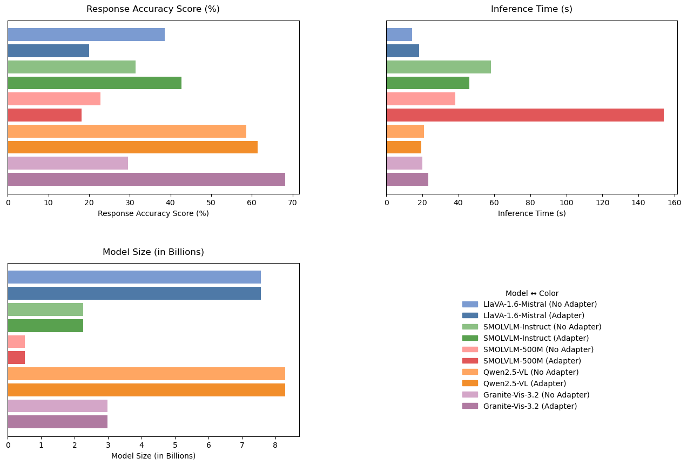
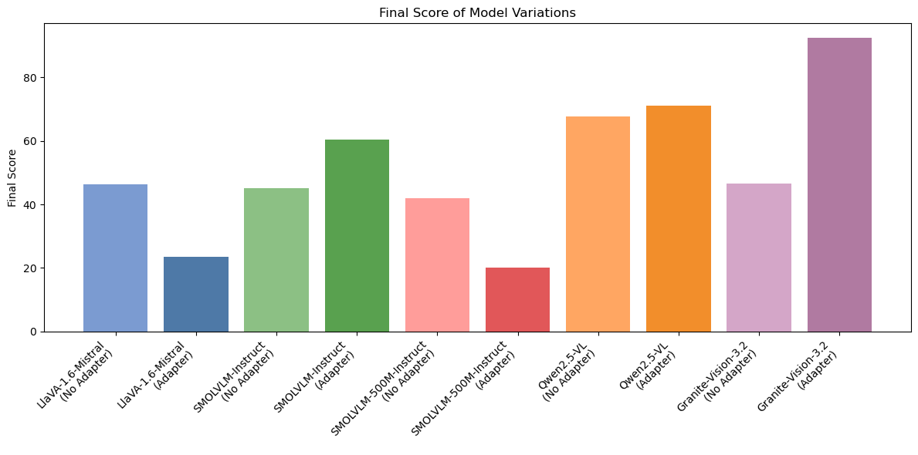
SI Analysis Performance Evaluation

Slide 18
SI Analysis Performance Evaluation
Model Variant | Strengths | Drawbacks
LlaVA-1.6-Mistral (no adapter) | References two time-domain plots; avoids star-topology hallucination | Uses 0–40 s timescale; mislabels bottom plot as close-up or frequency domain
LlaVA-1.6-Mistral (adapter) | Consistent descriptive detail | Completely ignores waveforms; hallucinates star-topology PCB rendering
SmolVLM-Instruct (no adapter) | Enumerates multiple waveform traces | Wrong amplitude/time scale (0–2 mV); ignores negative current dips; lacks cohesive summary
SmolVLM-Instruct (adapter) | Correctly cites ~3.3 V top and ~10–20 mA bottom; mentions fast transitions | Omits negative dips; scale confusion (0–40 ns vs s); lacks overshoot/reflection details
SmolVLM-500M (no adapter) | Fast, brief enumeration | Highly inaccurate amplitude/time refs; rarely mentions current plot or negative dips
SmolVLM-500M (adapter) | Detailed step-by-step enumeration | Long, repetitive descriptions; wrong amplitude (2.5 mV); ignores second plot
Qwen2.5-VL (no adapter) | Identifies voltage vs. current waveforms accurately | Uses 0–40 s timescale; misstates amplitude (±10–30 A or ~30 V); no negative dips
Qwen2.5-VL (adapter) | Recognizes overshoot/undershoot and reflections; clear waveform roles | Still uses wrong timescale/amplitude; sometimes invents extra lines; rarely mentions negative dips
Granite-Vision-3.2 (no adapter) | Notes top=voltage & bottom=current | Describes waveforms as sinusoidal/AC-like; misses amplitudes & negative dips
Granite-Vision-3.2 (adapter) | Accurate ~3.3 V square & negative mA dips; mentions ringing/reflections | Numeric approximations (e.g., exact 2 ns or 20 mA); occasional scale mismatches

Slide 19
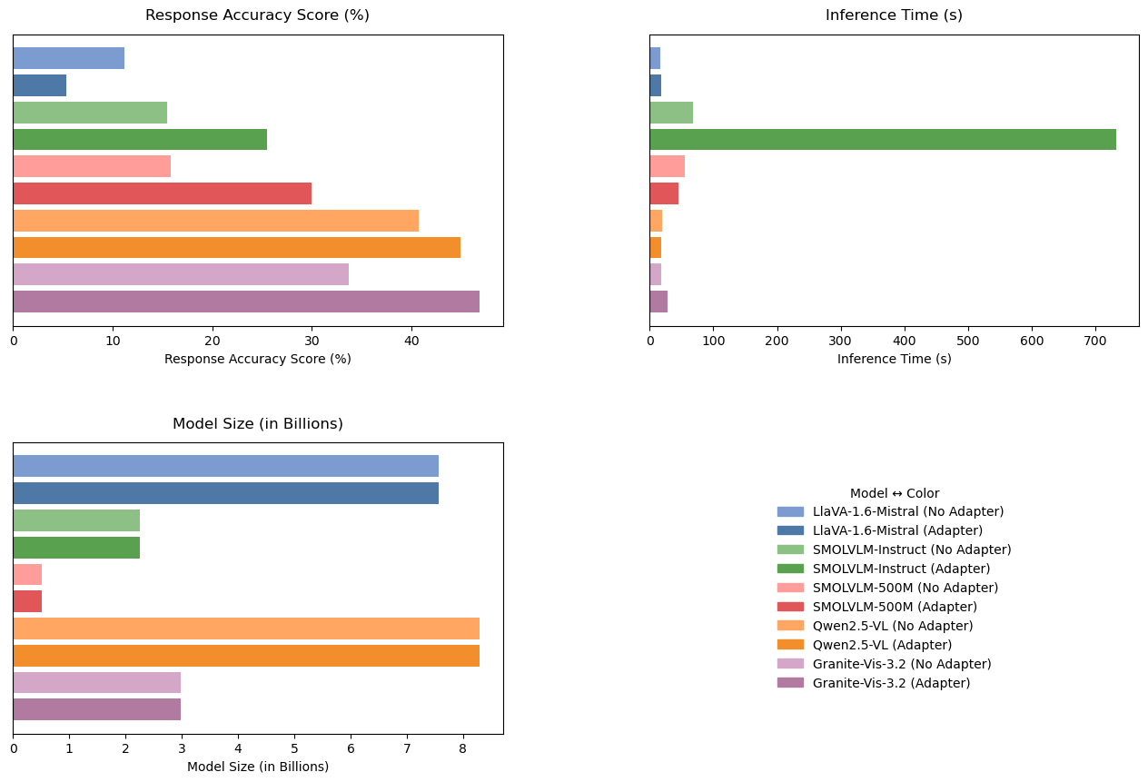
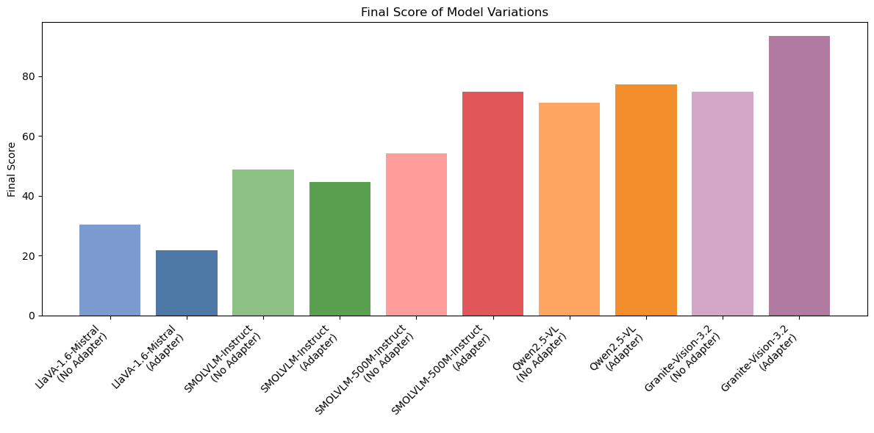
FD Analysis Performance Evaluation

Slide 20
FD Analysis Performance Evaluation
Model Variant | Strengths | Drawbacks
LlaVA-1.6-Mistral (no adapter) | Acknowledges source as PCB simulation/design; recognizes it’s a frequency-domain plot | Confuses FD plot with time-domain waveforms; rarely references S-parameters or frequency
LlaVA-1.6-Mistral (adapter) | Mentions “PCB design” generically | Hallucinates 3D star-topology PCB; no numeric or shape-based analysis
SmolVLM-Instruct (no adapter) | Recognizes frequency vs. S-parameter magnitude line graph | Lacks numeric detail; waveform shape (dips/oscillations) not described
SmolVLM-Instruct (adapter) | Mentions frequency-domain analysis and S-parameter magnitude; notes mismatches/reflections | Imagines separate phase plot; numeric details off; shape only partially captured
SmolVLM-500M (no adapter) | Identifies frequency axis and magnitude in dB; some mention of peaks/dips | Produces repeated/off-topic numeric descriptions; rarely captures true shape
SmolVLM-500M (adapter) | Identifies S-parameter magnitude plot; occasionally notes resonance dips | Numeric ranges misaligned with actual dips; lacks thorough shape explanation
Qwen2.5-VL (no adapter) | Recognizes two traces as frequency response with dips/resonances | Incorrect numeric refs (e.g., 0 to –80 dB); inconsistent or partial information
Qwen2.5-VL (adapter) | Identifies S11 vs. S21 roles; describes red dips/peaks and green stability; notes reflection | Numeric guesses often inaccurate; occasional misaligned dB references
Granite-Vision-3.2 (no adapter) | States red = magnitude, green = phase; identifies a frequency-magnitude plot | Incorrect frequency scale (e.g., audio kHz); misses large negative dips
Granite-Vision-3.2 (adapter) | Accurately describes FD magnitude response; notes red dips, green stability; mentions ringing | Numeric approximations off; occasional axis or detail mismatches

Slide 21
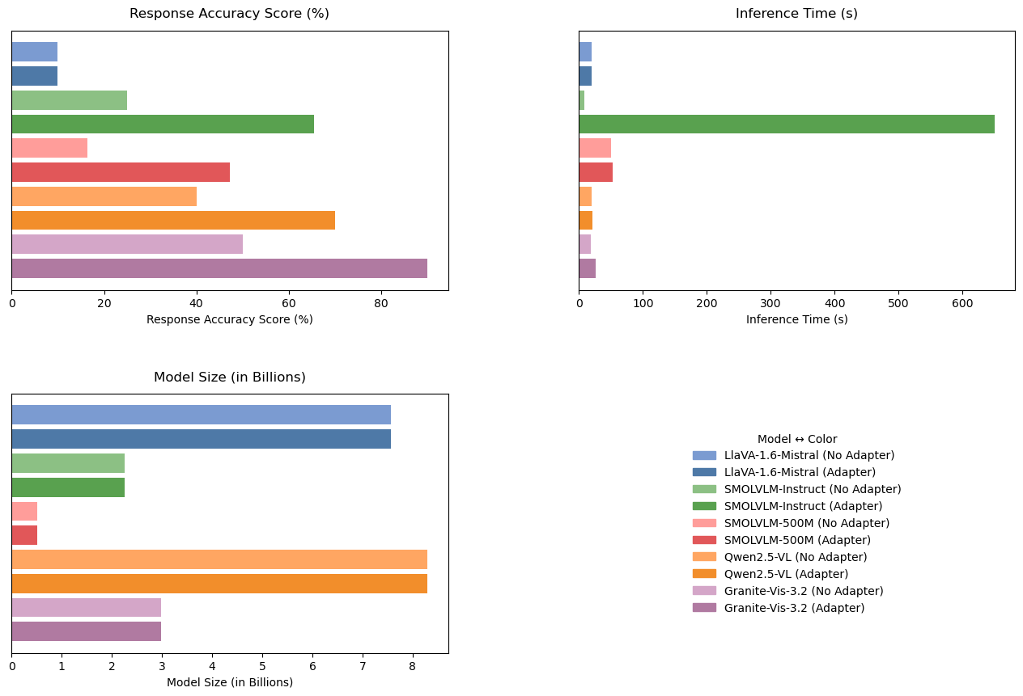
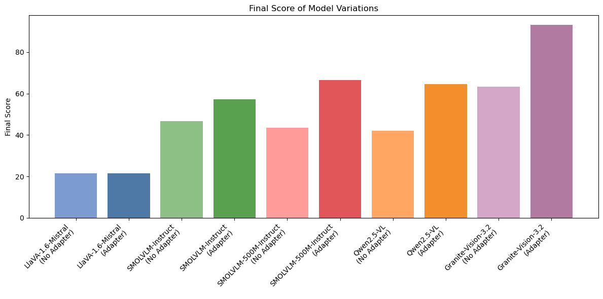
TDR Analysis Performance Evaluation

Slide 22
TDR Analysis Performance Evaluation
Model Variant | Strengths | Drawbacks
LlaVA-1.6-Mistral (no adapter) | Consistently references PCB layout. | Repeatedly described PCB layout screens or a “star topology” circuit instead of actual TDR waveforms.
LlaVA-1.6-Mistral (adapter) | Repeatedly generates PCB descriptions | Repeatedly described PCB layout screens or a “star topology” circuit instead of actual TDR waveforms.
SmolVLM-Instruct (no adapter) | Extremely fast inference times (often under 10 seconds). | Often misread the TDR plots as “tables” with constant or linearly rising voltage/current.
SmolVLM-Instruct (adapter) | Recognizes top/middle/bottom as voltage/current/impedance, references transients. | Numeric details are usually **off** (e.g., “2 A,” “200 mV,” or time scales from 0–2 ns).
SmolVLM-500M (no adapter) | Extremely fast inference times (often under 10 seconds). | Tends to meltdown about “Impedance (Impedance (Impedance…”), producing gibberish or irrelevant text.
SmolVLM-500M (adapter) | At least attempts to mention “voltage,” “current,” “impedance.” | Magnitudes are incorrect, rarely references TDR reflection or mismatch.
Qwen2.5-VL (no adapter) | Identifies “voltage/current/impedance,” notes “transient” or “step changes.” | Uses **seconds** instead of nanoseconds, numeric scales off (e.g., 30 mV → 60 Ω, etc.).
Qwen2.5-VL (adapter) | Distinguishes top/middle/bottom waveforms, mentions transients, new steady states. | Still uses second-scale timing and off numeric details.
Granite-Vision-3.2 (no adapter) | Usually identifies voltage/current/impedance waveforms. | Often claims “constant voltage/current” or describes it as a PSU test with stable lines, ignoring TDR steps.
Granite-Vision-3.2 (adapter) | Mentions rapid rise times, mismatch around 2–2.5 ns, new stable states, voltage/current/impedance stepping. | Numeric magnitudes (e.g., “300 mV → 400 mV,” “4.5 mA → 3 mA,” “50 Ω → 100 Ω → 200 Ω”) do not match actual scale but do reflect the **shape** of TDR transitions.

Slide 23
VLM Selection and Future Improvements
The Granite-Vision-3.2 model (fine-tuned) performs the best among all the models compared.
The possible reasons are,
It was pre-trained on charts, infographics, plots, etc., enabling it perform better in interpreting graphs and waveforms.
Unlike other models (such as LlaVA-1.6) whose loss drops rapidly and plateau (indicating possible overfitting), Granite-Vision’s loss reduces gradually indicating better generalization.
Future Scope and Improvements:
Adding more topologies into dataset, since our dataset only consisted of P2P topology circuits.
We could improve the performance by further fine-tuning the hyperparameters during training.
WIth the rapidly evolving landscape of LLMs and VLMs, newer and better models with different architectures could outperform the Granite-Vision models.

Slide 24


File and Web RAG Architecture
LLM Agent
Web Search (RAG)
Multiple File Upload (RAG)
Google (API)
DuckDuckGo
Brave
Bing
Yahoo
StartPage
PDF
CSV
DOCX
XLSX
PPTX
mistral:7b
deepseek-r1:1.5b
deepseek-r1:7b
deepseek-r1:14b
qwen2.5:7b
gemma2:latest
llama3.1:latest

Slide 25





Supported File Types
Document Files
Data Files
PDF: Extracted using PyMuPDF or pdfplumber
CSV: Processed using pandas
DOCX: Processed with python-docx
XLSX: Processed using pandas
Presentation Files
PPTX: Handled via python-pptx

Slide 26





Search Engines
Google | 100 queries/day
SerpAPI (Google Scraper) | 100 searches/month
Brave Search API | 2,000 queries/month
Whoogle API | Requires self-hosting
Bing Search API | 1000 requests/month
DuckDuckGo | Free

Slide 27
Web RAG
Two Methods (Get Links)
1. Web Seach API -Google
2. WebScraping (BeautifulSoup)
duckDuckGo
Brave
Bing
Yahoo
startPage
Search Query
Number of Queries
Load web Pages
Langchain (webBaseLoader)
Search Engine
Google (API)
DuckDuckGo
Brave
Bing
Yahoo
StartPage
Text Splitter
size=500
overlaping=50
Preprocessing
BeautifulSoup
regex
Database
ChromaDB
Embedding (vectorize)
GPT4AllEmbeddings

Slide 28
Document Rag
PDF
CSV
DOCX
XLSX
PPTX
Saved to Folder (data)
Landchain Document Loader
Files
Text Splitter
size=500
overlaping=50
Database
ChromaDB
Embedding (vectorize)
nomic-embed-text
Check for Existing Documents

Slide 29
Retrieval RAG
Question
Result
mistral:7b
deepseek-r1:1.5b
deepseek-r1:7b
deepseek-r1:14b
qwen2.5:7b
gemma2:latest
llama3.1:latest
Model
Database
ChromaDB

Slide 30


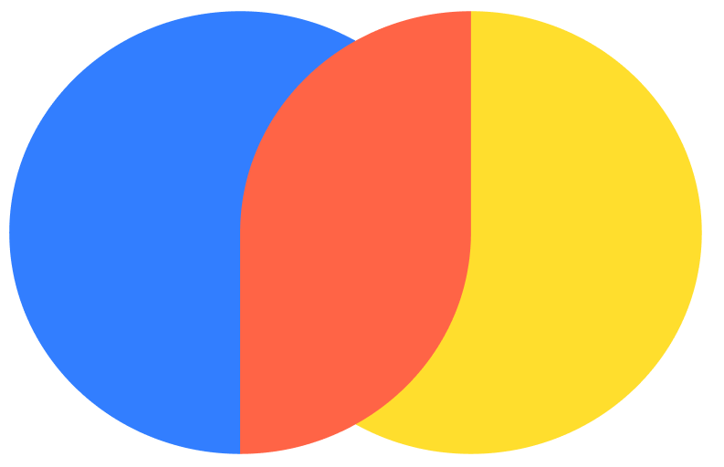
Backend Implementation
LangChain for Orchestration
Ollama for LLM Execution
Manages interactions between modules. Handles prompt engineering, memory, and structured outputs.
Manages various open-source LLMs. Provides flexibility for different use cases.
ChromaDB for Vector Storage
Stores text embeddings. Enables high-speed retrieval based on semantic similarity.

Slide 31




Future Enhancements
Multi-Engine Search UI
Implement interface for dynamic search engine selection.
Retrieval Mechanism Fusion
Merge Group 2's retrieval methods with current system.
Database Integration
Combine ChromaDB with Group 2's database solution.
Intelligent Query Routing
Fine-tune LLM to choose between Web or File RAG pathways.

Slide 32
Thank You :)

